Slide 1


BY
Dipta Bhattacharjee

Slide 2
INTRODUCTION
Business Problem
We have been provided data from a Telecom client which provides micro-credit on mobile-balance (TT as well as data) to its customers. The company provides micro-credit to the customers which are to be paid within a period of 5 Days. The target is to build a model which will help the client to identify the defaulters and target customer who will be able to pay back the loan back within 5 Days based of the historical data.
Background of the Problem
As mobile communication almost a basic necessity of life today, so it always important for a Telco to have a well defined strategy to increase revenue by identifying the targeted customer with low income and introduce micro loans for emergency balance top up. We can say almost all of the customers would be mostly taking loan for calling and not for internet services. So, the focus should be on the main balance .

Slide 3
Objective
The main objective of this Project is to identify the key factors and build a model which can be used to predict in terms of a probability for each loan transaction, whether the customer will be paying back the loaned amount within 5 days of loan or not.

Slide 4
General Problem Description
This a binary Classification problem with two label classes
The target classes are highly imbalance, imbalance must be addressed
It consists of 32 features in the dataset with are more than 200K samples in the dataset with no missing values.
All the Data is of numerical data type.
Almost all of the features are highly skewed, skewness is to be addresses.
Some dirty values were there needs to cleansed
The data is not scaled.
As the target contains highly imbalance classes (85%-15%), we may use AUC_ROC as the primary scoring and evaluation metric

Slide 5
Data Pre-processing
Skew transformation using Cube root Transformation (cbrt).
Reducing Dimensions by removing the features with about 0 percent variance.
Over Sampling of the minority class using SMOTE. Increased minority class samples by 1.5% only.
Last 0.5 Percent of Quartile stripped for 2 features with highly skewed data, with loss was about 1300 records
Standard Scaling the data

Slide 6
Hardware and Software Requirements and Tools Used
Hardware
    Intel Core i5 3rd Gen.
    Quad Core, 1.6 GHz Clock Speed.
    8 GB DDR4 RAM.
    1 TB Hard Disk.
    13.3 inches, 1920 x 1080 pixels, Touch Screen.
    Windows 10 OS.
Software
    Junyper.
    MS WORD.
    MS Excel.

Slide 7
Libraries Used :
Numpy
Pandas
Scipy
Sk-learn
Matplotlib
Seaborn
Joblib
.
Testing of Identified Approaches (Algorithms).
Logistic Regression
SVC (with an rbf kernel)
Decision Tree
K Nearest Neighbour
Random Forest
Gradient Boosting

Slide 8
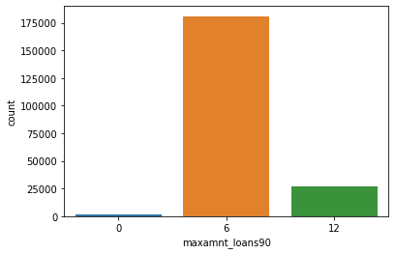
Visualizations
Most popular Loan
  Most of the customers preferred the 6 Indonesian Rupiah than 12 Rupiah.
  There are some samples in the dataset that haven't taken any loan yet.

Slide 9
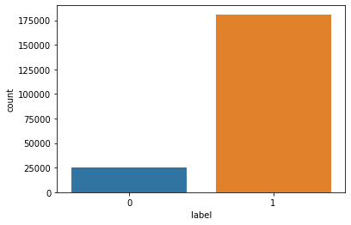
The target classes are highly imbalanced

Slide 10
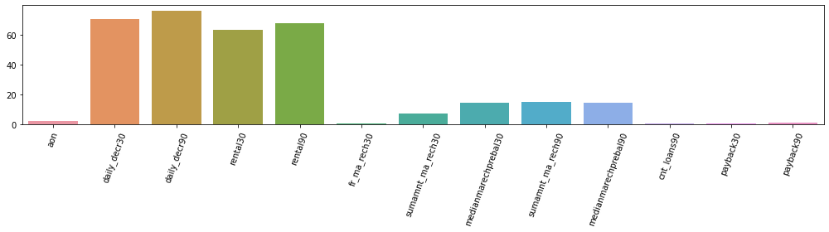
Prominent Features chosen for data modelling

Slide 11
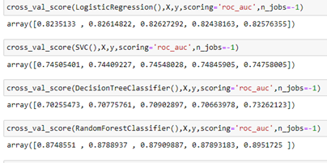
MODEL Tested
The metrics on which we have evaluated the model is AUC_ROC with 5 Folds and 3 Times repeated Stratified Cross Validation.
Random Forest Classifier is the best algorithm as it is giving us the best results.
WOODGROVE
BANK

Slide 12
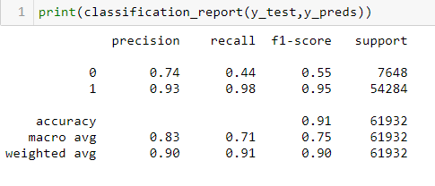
Interpretation of the Results
Classification Report
This is the classifications report on the test set. Since we have high imbalance in our target classes we used AUC_ROC to evaluate the model.

Slide 13
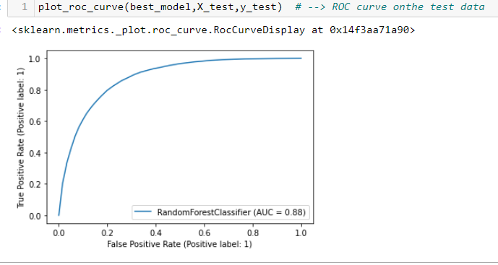
ROC curve on the test data
We received a AUC score of 88% on the test data using Random Forest

Slide 14
CONCLUSION
A very few of the customer take loan for Internet Services.
Most of the features pay their loan with interest on time.
Most of the population opt for the loan of 06 Units rather 12 Units.
Ensemble Techniques learn large data well without any extra-ordinary requirements.

